Slide 1
Python Functions
Notes:
Next Keywords

Slide 2
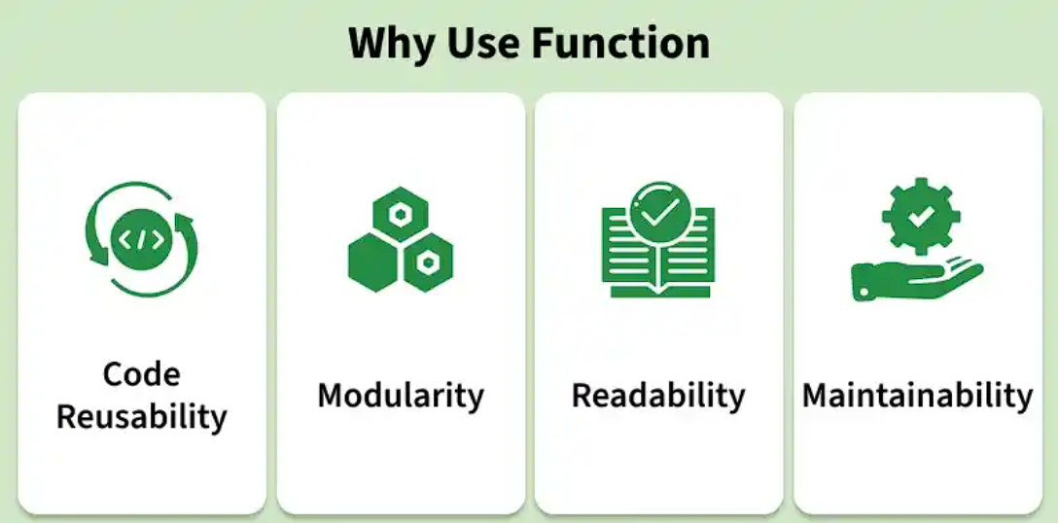
Python functions are reusable blocks of code used to perform a specific task. They help organize programs into smaller sections and execute the same logic whenever needed by calling the function.

Slide 3
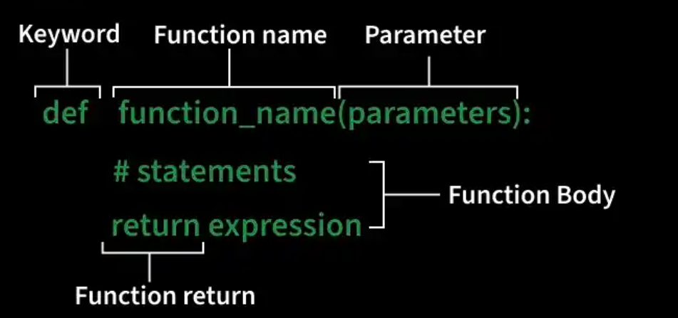
Defining a Function
A function can be defined using def keyword. Below is the syntax to define a function:

Slide 4
Here, we define a function using def that prints a welcome message when called.
def fun():
print("Welcome to CLASS")
Calling a Function
After creating a function, call it by using the name of the functions followed by parenthesis containing parameters of that particular function.
def fun():
print("Welcome to CLASS")
fun()
Output
Welcome to CLASS

Slide 5
Function Arguments
Arguments are values passed to a function when it is called. They allow functions to receive input data and perform operations using those values.
Syntax
def function_name(arguments):
# function body
return value
def function_name(arguments): defines a function with optional arguments.
# function body contains the statements to be executed.
return value returns a result from the function. If no return statement is used, it returns None by default.
Example: In this example, function checks whether the number passed as an argument is even or odd.
def evenOdd(x):
if (x % 2 == 0):
return "Even"
else:
return "Odd"
​
print(evenOdd(16))
print(evenOdd(7))

Slide 6
Types of Function Arguments
Python supports different types of arguments that can be passed during a function call.
1. Default argument: Default argument use a predefined value when no value is passed during the function call.
def myFun(x, y=50):
print("x: ", x)
print("y: ", y)
​
myFun(10)
Output
x: 10
y: 50
Explanation:
y=50 sets a default value for parameter y and myFun(10) passes only one argument.
Since y is not provided, it uses the default value 50.
2. Keyword Arguments: pass values using parameter names, so argument order does not matter.
def student(fname, lname):
print(fname, lname)
​
student(fname=‘PYTHON', lname='Practice')
student(lname='Practice', fname=‘PYTHON')
Output
PYTHON Practice
PYTHON Practice
Explanation: fname and lname are passed using parameter names and arguments can be provided in any order.

Slide 7
3. Positional Arguments: values are assigned to parameters based on their order in the function call.
def nameAge(name, age):
print("Hi, I am", name)
print("My age is ", age)
​
print("Case-1:")
nameAge("Olivia", 27)
​
print("Case-2:")
nameAge(27, "Olivia")
Output
Case-1:
Hi, I am Olivia
My age is 27
Case-2:
Hi, I am 27
My age is Olivia
Explanation:
In Case-1, values match the correct parameters.
In Case-2, values are swapped because the order changed

Slide 8
4. Arbitrary Arguments: allow functions to accept multiple values. This is done using two special symbols:
*args collects extra positional arguments as a tuple.
**kwargs collects extra keyword arguments as a dictionary.
def myFun(*args, **kwargs):
print("Non-Keyword Arguments (*args):")
for arg in args:
print(arg)
​
print("Keyword Arguments (**kwargs):")
for key, value in kwargs.items():
print(f"{key} == {value}")
​
myFun('Hey', 'Welcome', first=‘TO CLASS', mid='for', last=‘LECTURE')
Output
Non-Keyword Arguments (*args):
Hey
Welcome
Keyword Arguments (**kwargs):
first == TO CLASS
mid == for
last == LECTURE
Explanation:
*args stores extra positional arguments.
**kwargs stores extra keyword arguments.
loop prints all positional and keyword values separately.

Slide 9
Function within Functions
A function defined inside another function is called an inner function (or nested function). It is used to organize related logic and access variables from the outer function.
def f1():
s = 'I love Python'
def f2():
print(s)
f2()
f1()
Output
I love Python
Return Statement
Return is used to end a function and send a value back to the caller. It can return any data type, multiple values (packed into a tuple), or None if no value is given.
Syntax
return [expression]
Parameters: expression is the value returned by the function. If no value is returned, it returns None by default.
def sq_value(num):
return num**2
​
print(sq_value(2))
print(sq_value(-4))
Output
4
16
Explanation:
sq_value(num) accepts a number as input.
num**2 calculates the square of the number.
return sends the result back to the caller.

Slide 10
Pass by Reference and Pass by Value
Variables refer to objects. Function behaviour depends on whether the object is mutable or immutable.
Mutable objects like lists can be modified inside functions.
Immutable objects like integers and strings remain unchanged.
def myFun(x):
x[0] = 20
​
b = [10, 11, 12, 13]
myFun(b)
print(b)
​
def myFun2(x):
x = 20
​
a = 10
myFun2(a)
print(a)
Output
[20, 11, 12, 13]
10
Explanation:
myFun(x) modifies the first element of the list and lists are mutable, so the original list changes.
myFun2(x) assigns a new value to x. Integers are immutable, so the original value of a remains unchanged.
Note: Python uses pass-by-object-reference, where functions receive references to objects instead of actual copies.

Slide 11
Thank you….
Sahil shaikh
Python Trainer

